Slide 1
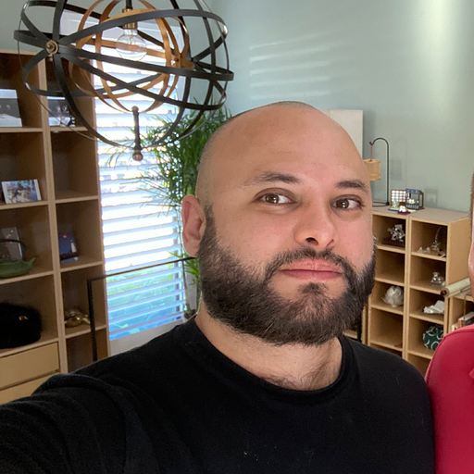



Deep Learning Based Covid-19 Identification
Joe Villasenor
Ryan Mitchell
Manohar Madhira
Napoleon Paxton
Notes:
Intros
The goal of our group project is to utilize deep learning techniques at the edge to assist doctors and patients in the detection of COVID-19 and help differentiate between viral and bacterial infections in the throat.

Slide 2
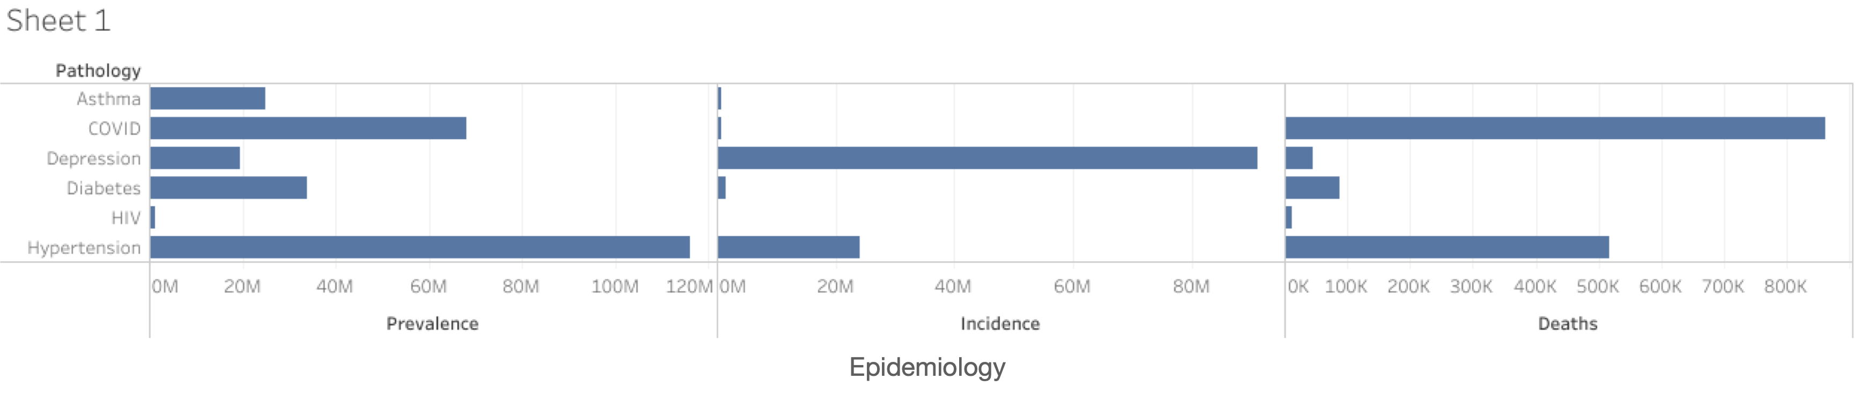
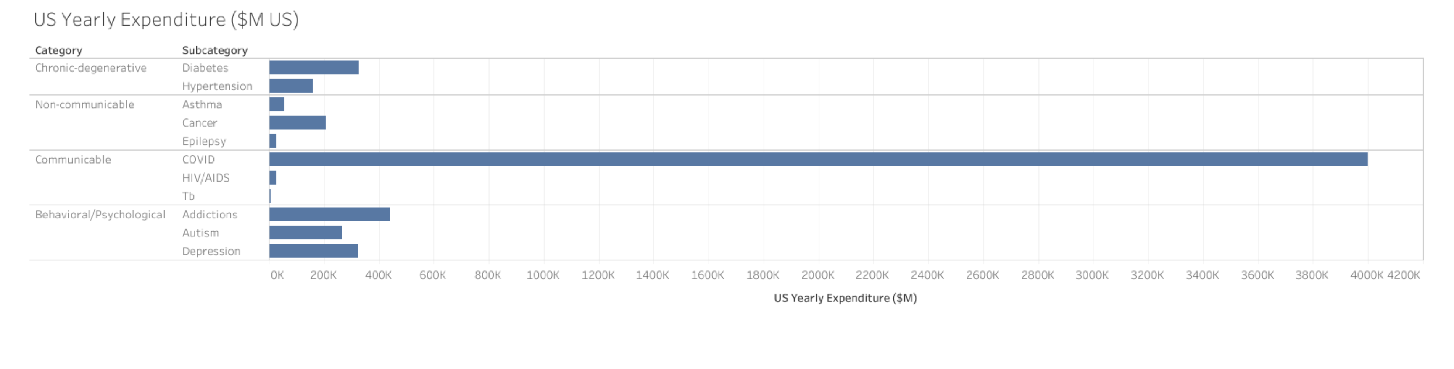
Why is early diagnosis important?
CDC reported data from Jan 2022
** Deaths through week ending 1/22/2022
*** Daily Cases reported by CDC
CDC (Chronic Disease Program Impact) link . Polaris Report link
** Financial Burden of Cancer Care (cancer.gov), Cost of Asthma on Society AAFA report, Economic Impact Epilepsy AJMC
*** bloomberg.com, Federal HIV budget hiv.gov, who.int
**** prnewswire, recoverycentersofamerica.com (Drugs, Alcohol and Health Report)
Notes:
Speaker: Joe
When it comes to understanding the impact a disease has, we need to understand 4 main aspects of its impact:
1) Prevalence, which is the number of people in a determinate period of time (1 year) that have the disease
2) Incidence, are the new cases that are diagnosed with such disease.
3) Death rate
4) Government expenditure.
When we just look at one of these parameters alone, we get a wrong idea of how to tackle the disease.
High mortality, with low early diagnosis, affects both real incidence and prevalence (since we are not able to know the number of people with the disease or treat it properly.
Eventually, that impacts budgeting for future healthcare policies and strategies.
For example, Initially, we had scarce testing in the US. That didn't give us a real understanding of the spread rate of COVID and we are now facing budgeting issues for vaccination programs and hospital funding.

Slide 3
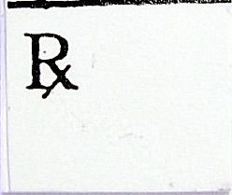
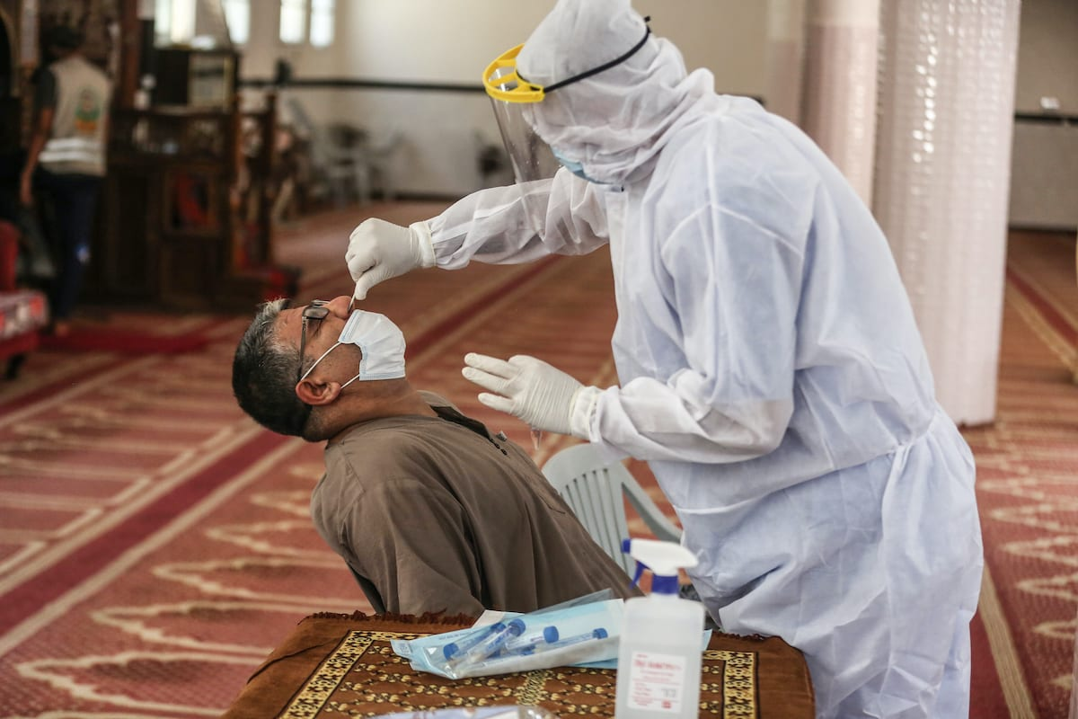
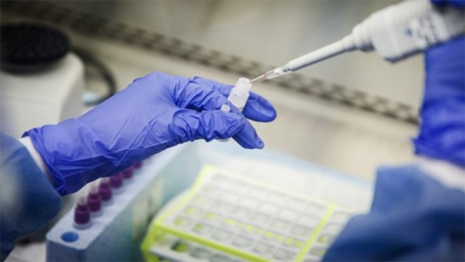
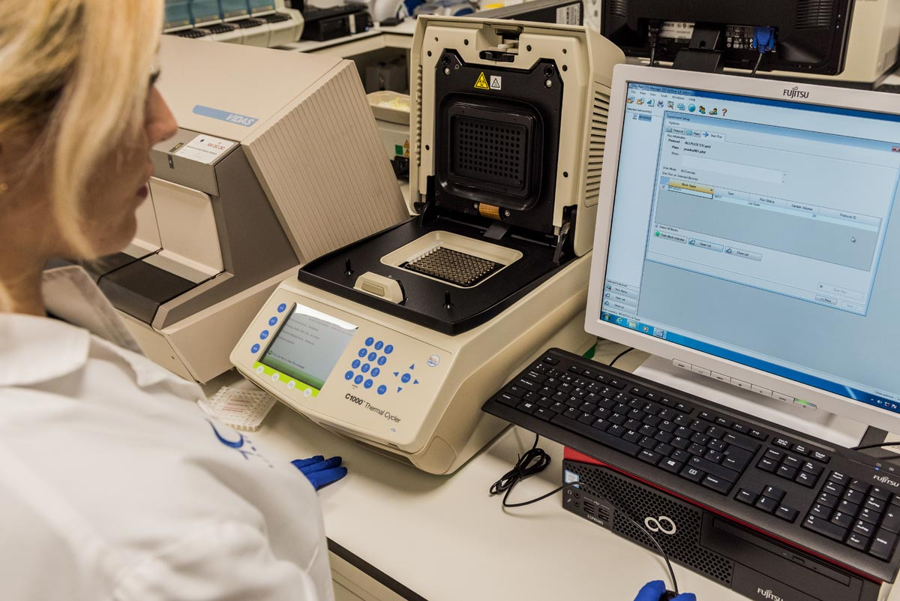



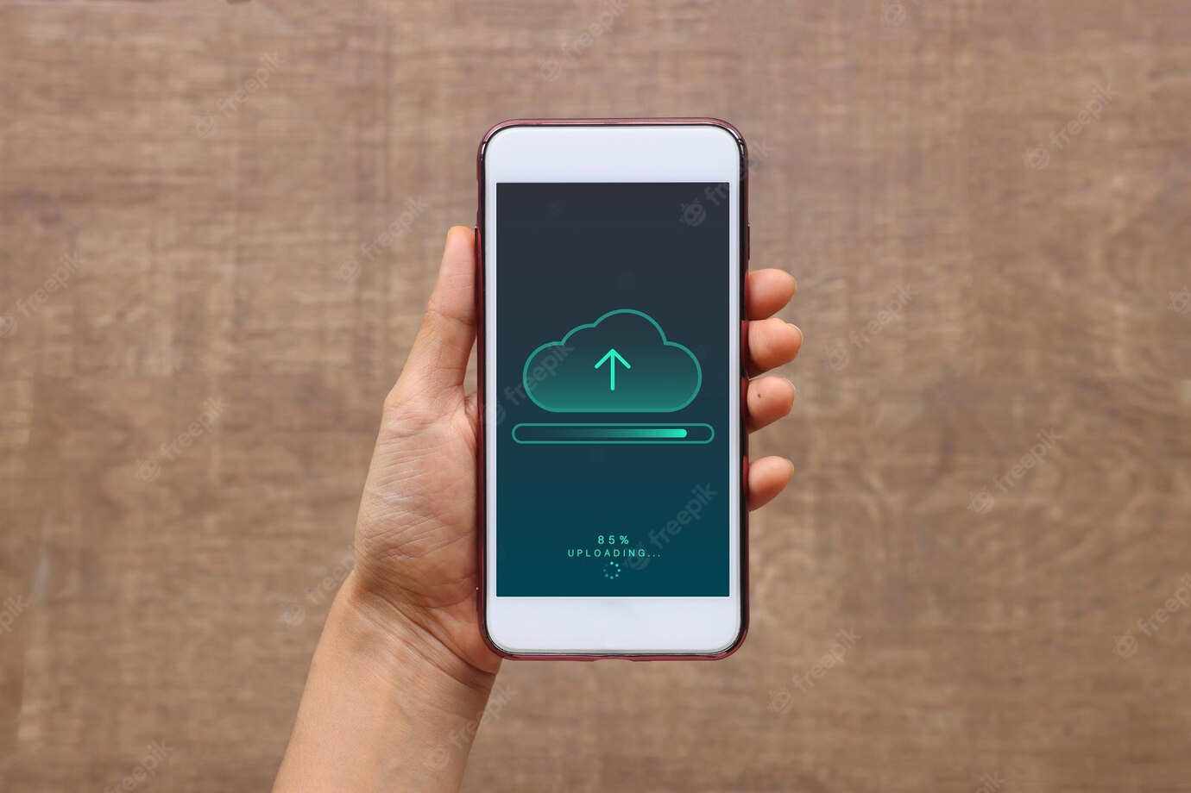

Today’s Process
Covid
No-Covid
What-if?
Normal
Bacterial
Covid
Notes:
Joe: As with any infection, early detection is key to minimizing the effects. Unfortunately, the current methods to detect COVID-19 require either over-the-counter testing kits or in-person testing. Issues with supply chain has shown us that over-the-counter testing is not always available and in-person testing can place potentially “negative” patients in an environment that they get exposed to Covid at the testing site.
What if... we could work towards remote disease detection using images and a short survey documenting the type and severity of symptoms, vaccination status, etc?

Slide 4


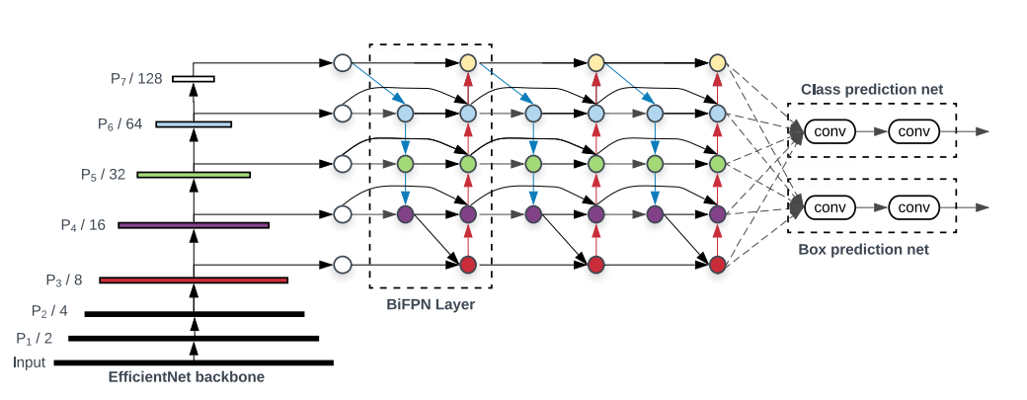
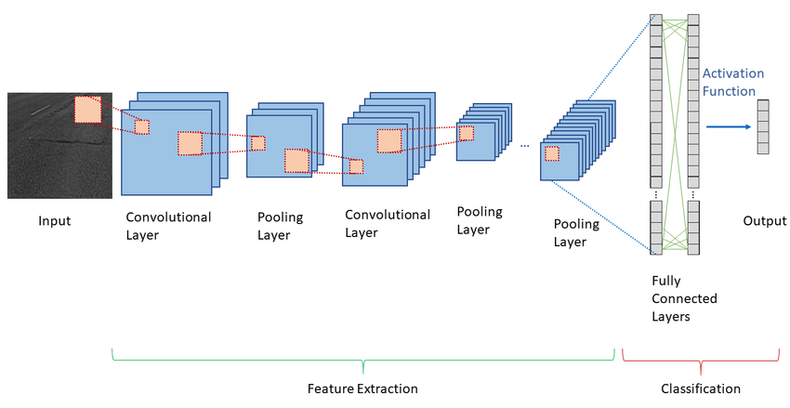
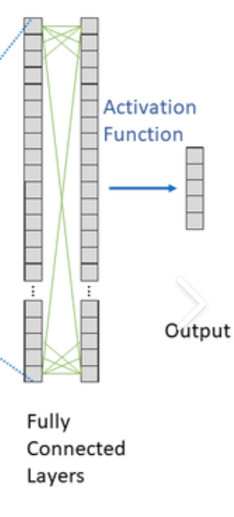
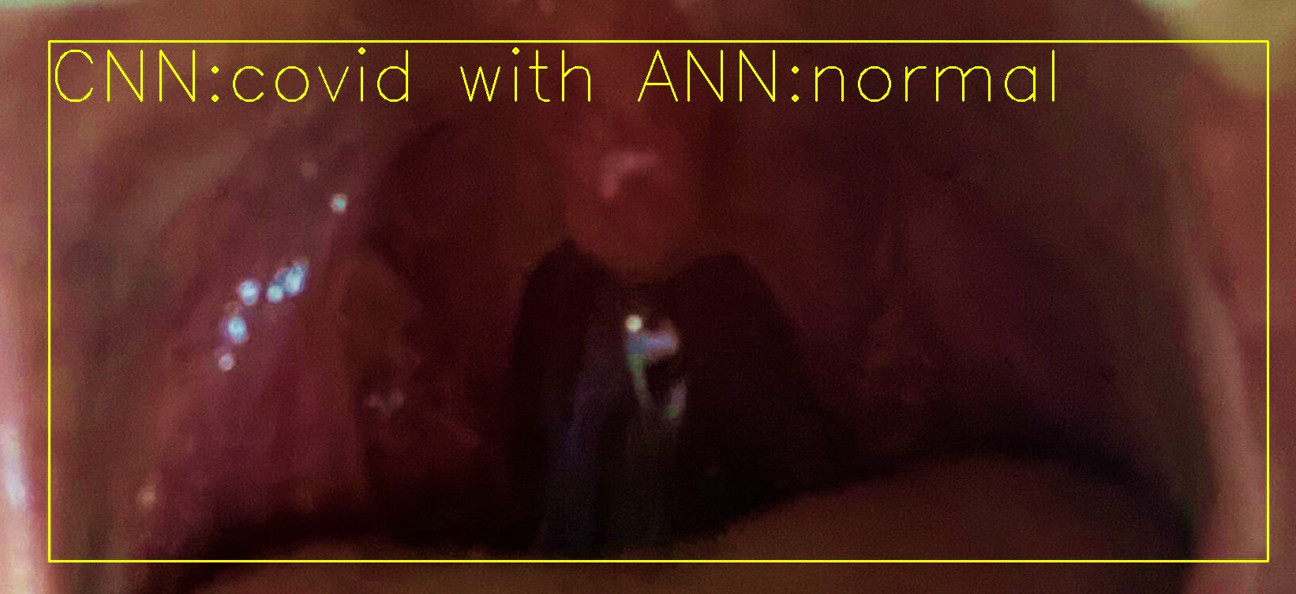

End Goal: Inference at the Edge (or Cloud!)
EfficientDet
CNN
CNN + ANN
Final Result
Metadata
Notes:
Joe: So the end goal here is to create an end to end solution where a patient or doctor can upload an image and some medical information about the patient, and get a prediction about whether the patient has bacterial pharyngitis, COVID 19, or neither. And that inference could take place on an edge device or through a web service with the models hosted in the cloud.

Slide 5
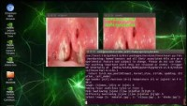
Demo from YouTube
https://youtu.be/-jzFMePNuzM

Slide 6
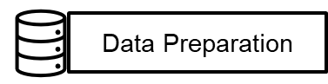
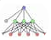


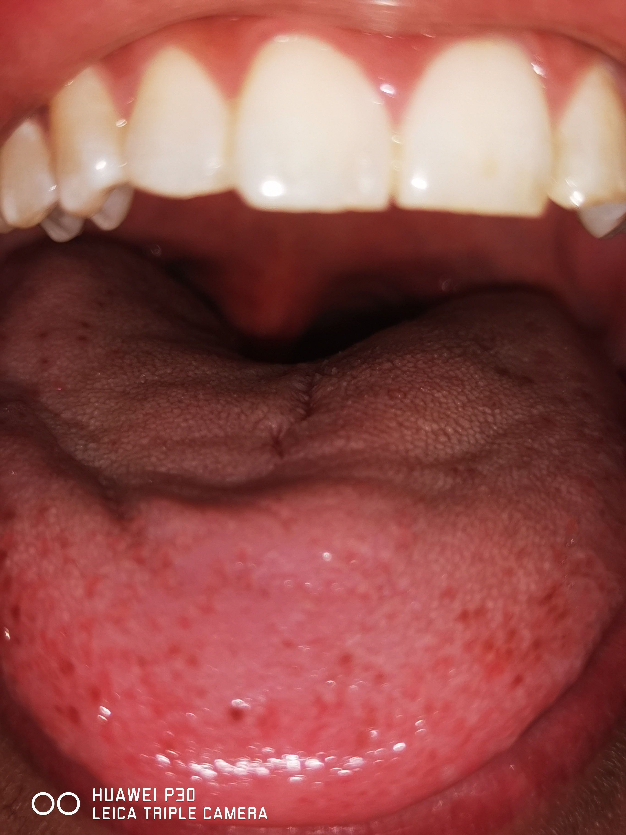
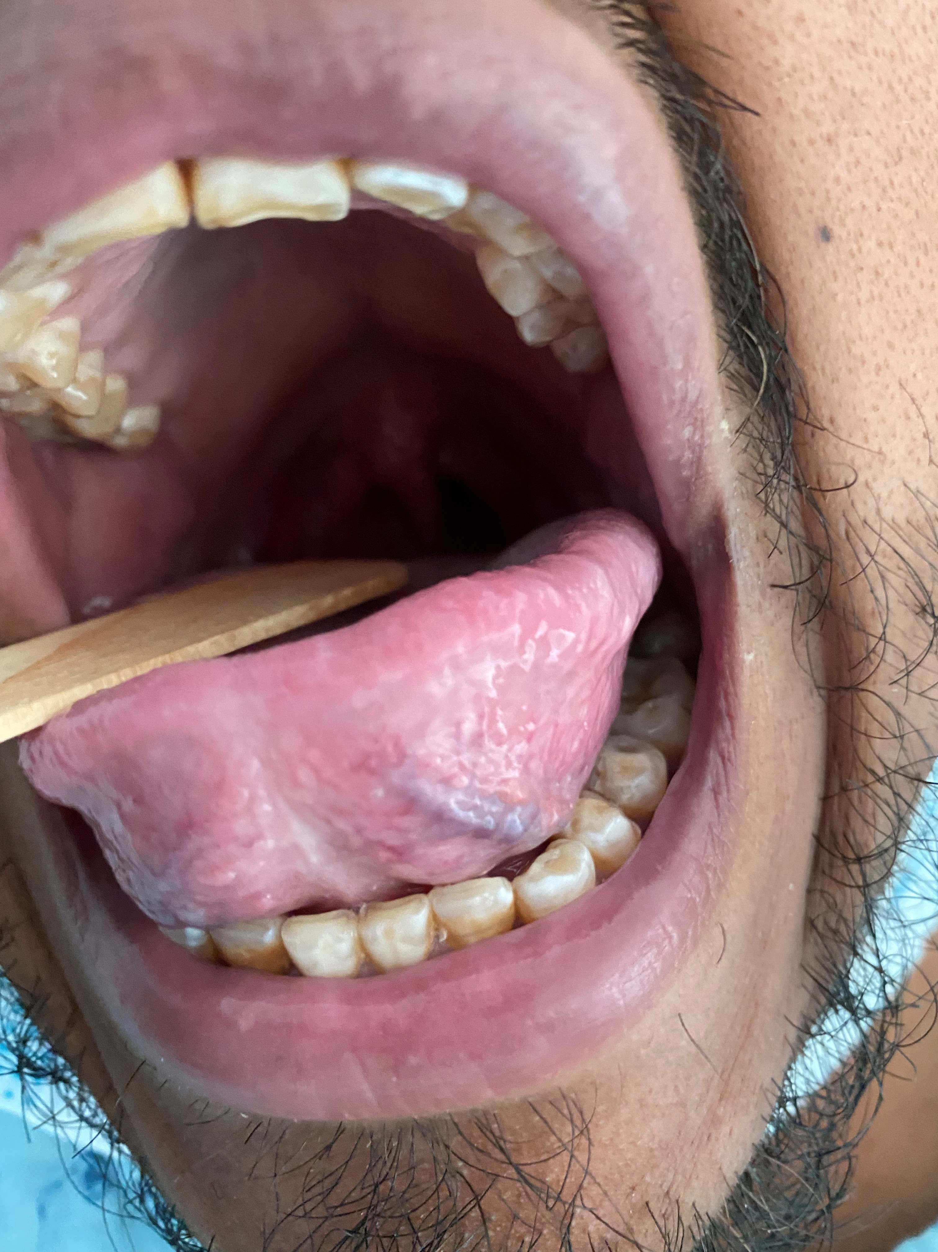
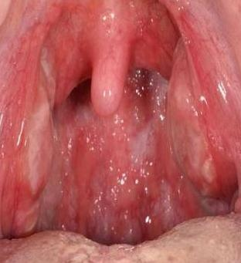


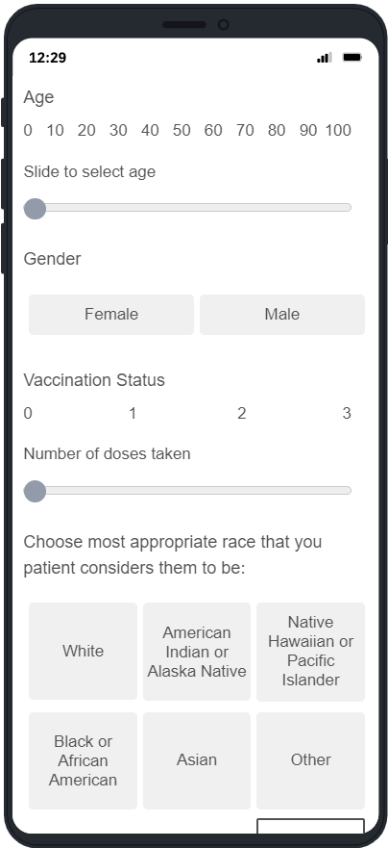

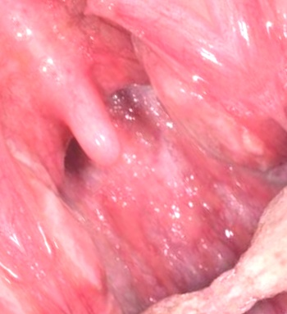
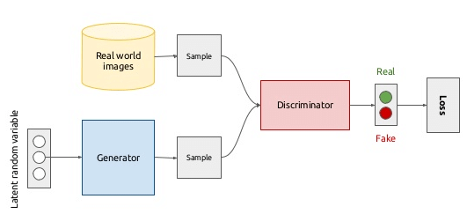
Training Process Flow
Machine Learning
train
VGG16 (CNN)
CNN+ANN
augmentation
Train/ Val / Test Split
by Patient
GauGAN
EfficientDet
Notes:
Speaker: Joe
To try to make remote COVID diagnosis a reality, we started by collecting data from a network of collaborators in the medical field.
The data included:
Age, Sex, and Race of the patient
Symptoms: fever, pain while swallowing, difficulty swallowing, cough, etc.
Vaccination status, Ag/Ab/PCR tests results
Diagnostic Impression
Date of Contagion (Approx.)
Clinical questionnaire for each photo of a patient with COVID
Pictures of a patient with or without added pathology (bacterial pharyngitis, another viral pharyngitis, or a healthy patient).
Then we started developing the architecture for the project, which

Slide 7
Preliminary Research on Existing Solutions
Instead of attempting to build everything from scratch, we performed a literature review to determine if there were projects with similar goals.
Deep Learning Classifier with Patient’s Metadata of Dermoscopic Images in Malignant Melanoma Detection, Anggraini, D. N. et. al.
An approach to train a classifier to detect skin cancer from images and to use the metadata to improve the accuracy.
Machine learning-based prediction of COVID-19 diagnosis based on symptoms (Nature Y Zoabi, S Deri-Rozov)
Toward automated severe pharyngitis detection with smartphone camera using deep learning networks (TaeKeun Yoo)
Notes:
Joe: Of course, we didn't want to build everything from scratch, we performed a literature review to determine if there were projects with similar goals, and designed our approach around what had worked well for other research teams.

Slide 8
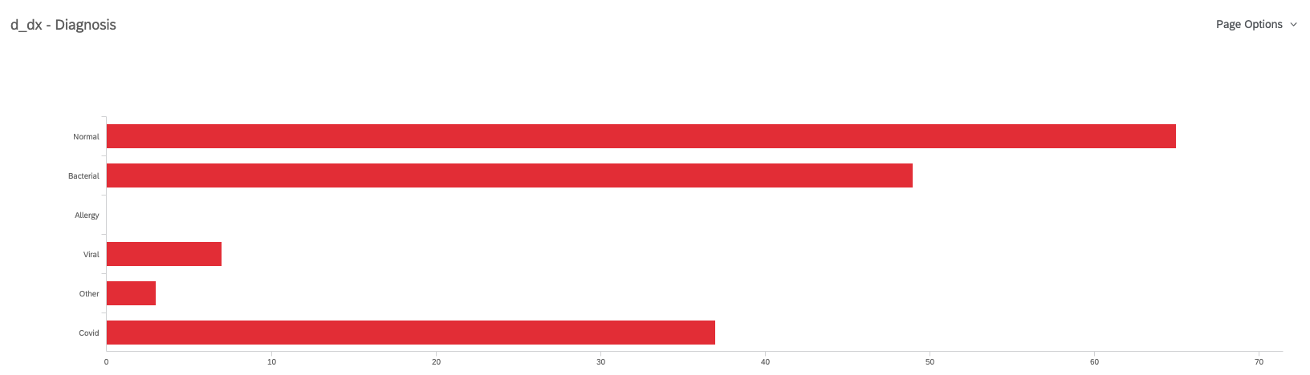
Data Collection
To effectively train a DL model to identify COVID-19, we needed a dataset composed of images labeled as normal, COVID-19, and bacterial.
Our SME was able to collect data from patients and colleagues
From initial estimates we determined we would need 200+ images for each class
Developed a Qualtrics survey to collect more data samples
All data adhered to HIPAA guidelines
Notes:
Speaker: Joe

Slide 9
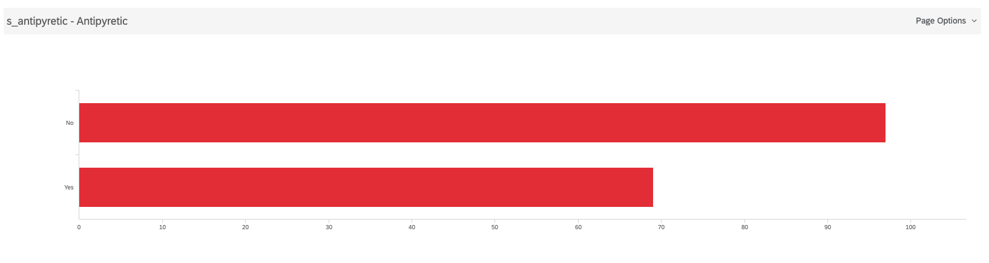
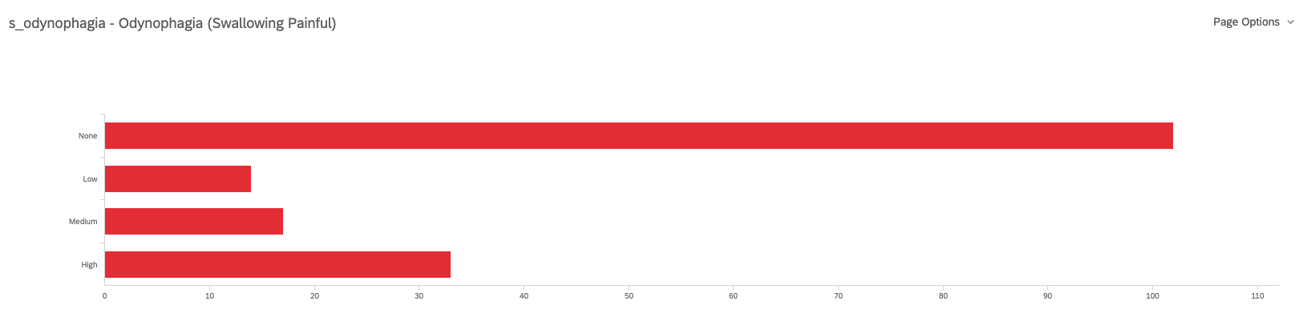
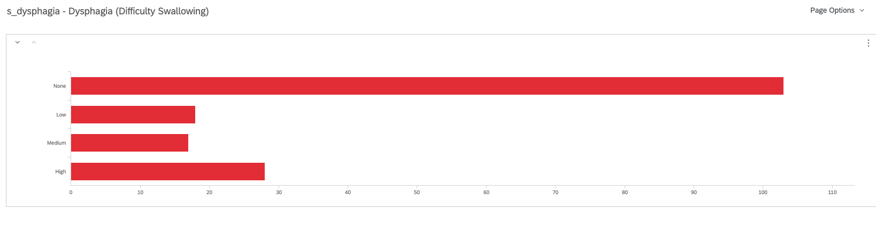
Triad
Notes:
A medical triad is a group of three signs or symptoms, the result of injury to three organs, which characterize a specific medical condition. The appearance of all three signs conjoined together in another patient, points to that the patient has the same medical condition, or diagnosis. Antipyretic can change the value of temperature.

Slide 10
Data Issues
After our first round of data collection, we realized the collection of test data would be more difficult than we originally thought.
Partner physicians forwarded images instead of using Qualtrics survey directly.
Some collaborators working in the COVID area were infected and had to take medical leave
Performing on-site training was preferred, we had to get a special permit to access these areas and comply with international security protocols
Stage of patients in-hospitals are usually stage 2 and 3
Low quality images reduced our usable images to 178 total before supplementation with GAN-generated images.
Notes:
Speaker: Joe
Our data came from doctors that work in secondary and tertiary level of care hospitals (where more complicated cases are referred by primary care physicians), also most of our patients that volunteered for our experiment were in stage 2 (Pneumonia/respiratory symptoms) and stage 3 (Organ failure), whereas the prevalence of COVID-19 is higher of those in stage 1: Flu-like symptoms or asymptomatic

Slide 11
GAN Image Generation
Based on the limited dataset, we determined we needed to generate images for each class to be used in our training. We used a Generative Adversarial Network (GAN) to generate new data.
We settled on a GauGAN (Gaussian GAN) implementation due to the simplicity of the overall network and the fact that it only requires a random noise vector as an input. We first generated a Spatially Adaptive Denormalization (SPADE), in which the denormalization parameters are spatially invariant (the same values are applied to every position in the input activation).
Image Classification | Number of Images
COVID-19 | 38
Normal | 54
Bacterial | 49
Notes:
Speaker: Joe
We experimented with different GAN architectures Cluster GAN, Coupled GAN, DualGAN, GauGAN, Pix2Pix, and eventually decided to use GauGAN due to the simplicity of the overall network and the fact it only requires a random noise vector as an input.
The first models took many hours to generate and the results were not even recognizable as human throats by physicians.

Slide 12
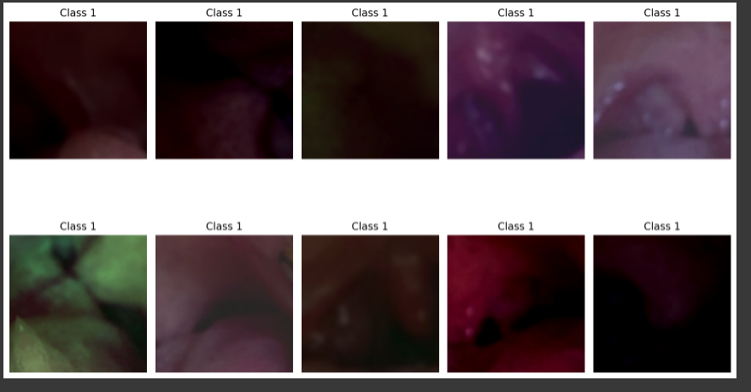
Initial GAN Results
Initial results resemble real throats, but for our purposes we need higher quality results to improve the training our model.
Encoder for GauGANs encodes the original image into a mean and standard deviation from which to sample noise, that is given to the generator.
The generator used the information from the semantic label map and adds that to each batch normalization layer, the noise is reshaped and upsampled to the target image size.
The discriminator’s architecture follows a multi-scale design with InstanceNorm applying spectral normalization to all convolutional layers. It also takes as input the image concatenated with the semantic label map. The Loss function imposed a soft 0.05 weight Kullbach-Leiber divergence (KLD) loss term on the Gaussian statistics generated by the encoder.
Notes:
Speaker: Joe
Encode of the GauGAN encodes the original image into a mean and standard deviation from which to sample noise
Generator adds to each batch normalization layer, the noise that is reshaped and upsampled to the target image size.
Discriminator follows a multi-scale design with InstanceNorm applying spectral normalization to all convolutional layers.
Loss function imposed a 0.05 weight KLD (Kullbach-Leiber divergence) loss term on the gaussian statistic generated by the encoder.

Slide 13
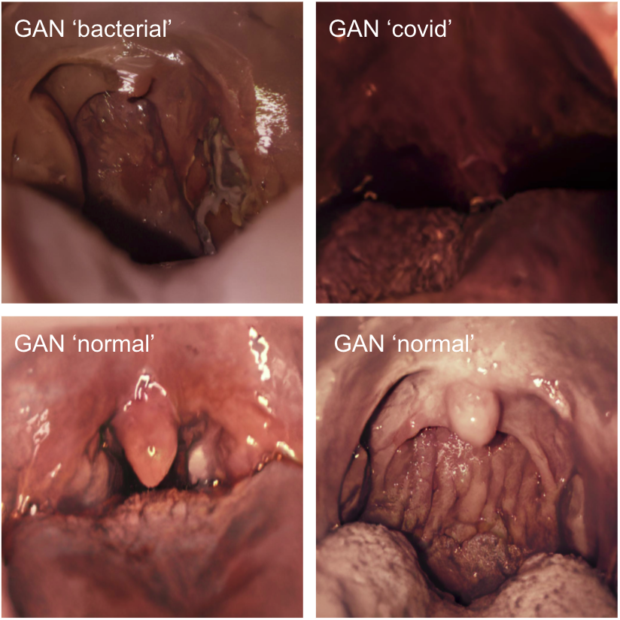
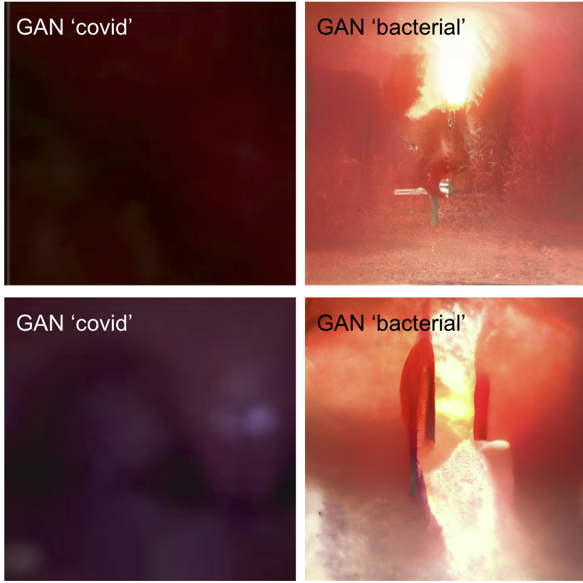
Updated GAN Results
After removing the dark images from the original set we were able to improve the quality of the images.
Only data from the training set was used to train the GAN to prevent any data ‘leakage’ from the validation and test sets.
The "good"
The "not so good"
Notes:
Speaker: Joe
After removing the dark images from the original set we were able to improve the quality of the images.
Only data from the training set was used to train the GAN to prevent any data ‘leakage’ from the validation and test sets.

Slide 14
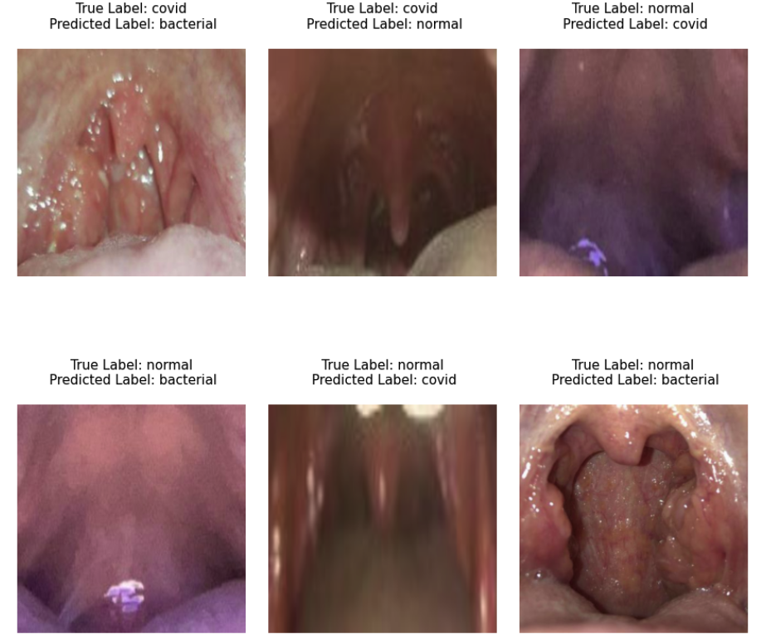
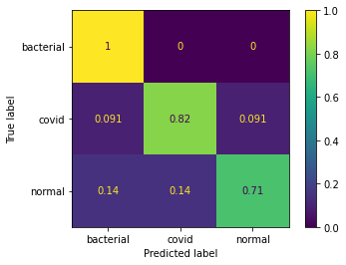
CNN (VGG-16) Results
Our best model was 82% accurate on the test set (image-level) and 88% accurate (patient-level). Of the misclassifications on test, it appears that the inclusion or exclusion of flash and overall image brightness could cause misclassifications.
#1
#2
#3
CNN Confusion Matrix
#4
#5
#6
Notes:
Speaker: Ryan
For the convolutional neural network, we used a slightly modified version of the well known VGG-16 architecture due to its strong performance in medical classification tasks. The data here show our image and patient level classification accuracies of 82% and 88% after 100 training epochs.
It's interesting to see some of the misclassified images. It looks like image #1, #4, and #6 were all misclassified as bacterial, possibly because of the camera flash mimicking white bacterial colonies.
So of course, the next step was to try different data augmentations to address those issues. (next slide)
-------Background on patient vs image level accuracy (in case of questions)
(Class predictions were averaged across images for patients that submitted multiple images). Patient level accuracy scores tended to be higher than image level accuracy scores because, for patients that submitted 2+ images, the models tended to consistently misclassify the images (as opposed to classifying one image correctly and the remaining images incorrectly). [IMAGES #3 and #4 ARE FROM SAME PATIENT]
During training, we determined that the pre-trained weights generalized better on the test set compared to randomized initial weights.

Slide 15
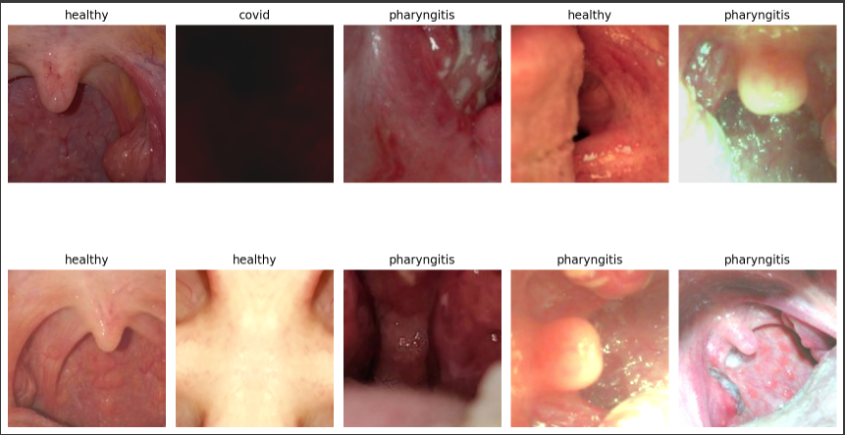
Data Improvements
To try improve upon the misclassifications of the CNN model, more data and further augmentations were added.
Flash-like effect augmentations
Color shifts
Image shift/scale/rotate
Hue & contrast shifts
GAN generated images
Notes:
Speaker: Ryan
We tried several different augmentation methods, including brightness and contrast changes to mimic camera flashes, scaling/shifting/rotating, RGB color shifts, adding random noise, changing the hue, and adding new training images from the GAN generated images.
But generally speaking, augmenting the training data did not impact the classification performance, and we actually started to see some overfitting on the training data as we brought in more augmentations. (next)

Slide 16
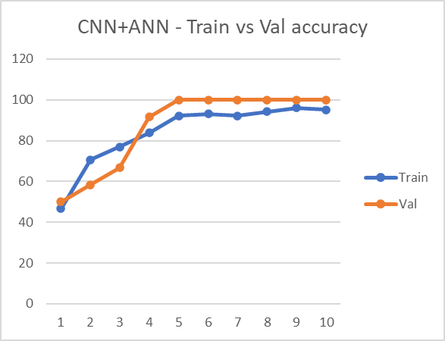
ANN Metadata Component
To evaluate the improvements the addition of patient metadata could have to our classification capability, we constructed a fully connected ANN layer to include metadata in our results.
Model | Patient Classification Accuracy
CNN (Image Only) | 87.5%
ANN (Metadata Only) | 92.3%
CNN + ANN | 100%
Notes:
Speaker: Ryan
And then, finally, we wanted to see how our classifications could improve after adding in the patient metadata, which we passed to a fully connected ANN layer.
For the ANN, we used a simple fully connected network with 1 input layer, 1 hidden layer and 1 output layer. Each layer had a bias term and used a ReLU activation function.
Without any input from the CNN, our ANN was able to classify 92% of patients in the test group correctly, which is already impressive. But when we added the image class scores from the CNN to the ANN model, we actually got our prediction accuracy up to 100% on the validation set.
The results were very promising, but we'll talk about some of the limitations of this approach and why our models might be over-performing on our dataset. (next slide)
--Additional context:
Cross entropy loss function

Slide 17
Discussion & Limitations
Balanced training data vs. imbalanced population distribution
If we were to roll out these models in their current state to the entire population, we would over-diagnose bacterial pharyngitis and COVID-19
Our COVID-19 patients skewed toward later disease stages
Smaller mouth openings = darker images
More likely to report with symptoms than earlier stages
Misclassification Risk
False negatives for bacterial pharyngitis or COVID-19 could cause some patients to not seek out preventative care and increase disease transmission
Notes:
Speaker: Ryan
So, first, our models are trained on data that is representative only of the patient population that visited our network of doctors, and the data was fairly balanced between normal, bacterial, and COVID cases, which is not necessarily representative of the overall population, where bacterial pharyngitis and COVID have low population prevalence.
So what that means is that if we rolled out this model to the entire population as-is, we would over-diagnose those classes.
But this is a classic class imbalance problem, and you will have to decide what tradeoffs you are willing to make.
Secondly, Our COVID-19 patients skewed toward later disease stages and had a harder time opening their mouths, which made the images darker. So it is possible that our CNN model had an easier time identifying COVID patients just because the images tended to be darker than normal and bacterial images.
And lastly, you also have misclassification risk: False negatives for bacterial pharyngitis or COVID could cause some patients to not seek out preventative care and also increase disease transmission. That's all we have for you guys today, so let's open it up for questions!

Slide 18
Questions?

Slide 19
Prior Research & References
[1] Zoabi, Y., Deri-Rozov, S. & Shomron, N. Machine learning-based prediction of COVID-19 diagnosis based on symptoms. npj Digit. Med. 4, 3 (2021). https://doi.org/10.1038/s41746-020-00372-6
[2] Mohammad-Rahimi, Hossein et al. “Application of Machine Learning in Diagnosis of COVID-19 Through X-Ray and CT Images: A Scoping Review.” Frontiers in cardiovascular medicine vol. 8 638011. 25 Mar. 2021, doi:10.3389/fcvm.2021.638011
[3] Noah, B., Keller, M.S., Mosadeghi, S. et al. Impact of remote patient monitoring on clinical outcomes: an updated meta-analysis of randomized controlled trials. npj Digital Med 1, 20172 (2018). https://doi.org/10.1038/s41746-017-0002-4
[4] Walker RC, Tong A, Howard K, Palmer SC. Patient expectations and experiences of remote monitoring for chronic diseases: Systematic review and thematic synthesis of qualitative studies. Int J Med Inform. 2019 Apr;124:78-85. doi: 10.1016/j.ijmedinf.2019.01.013. Epub 2019 Jan 29. PMID: 30784430
[5] Yoo, Tae Keun et al. “Toward automated severe pharyngitis detection with smartphone camera using deep learning networks.” Computers in biology and medicine vol. 125 (2020): 103980. doi:10.1016/j.compbiomed.2020.103980
[6] Ningrum, Dina Nur Anggraini et al. “Deep Learning Classifier with Patient's Metadata of Dermoscopic Images in Malignant Melanoma Detection.” Journal of multidisciplinary healthcare vol. 14 877-885. 21 Apr. 2021, doi:10.2147/JMDH.S306284
[7] Buda, Mateusz & Maki, Atsuto & Mazurowski, Maciej. (2017). A systematic study of the class imbalance problem in convolutional neural networks. Neural Networks. 106. 10.1016/j.neunet.2018.07.011

Slide 20
Deep Neural Network Based Approach
Deep Neural Network Architecture
Final Result
Camera Device
Metadata
Notes:
Joe: So the end goal here is to create an end to end solution where a patient or doctor can upload an image and some medical information about the patient, and get a prediction about whether the patient has bacterial pharyngitis, COVID 19, or neither. And that inference could take place on an edge device or through a web service with the models hosted in the cloud.

Slide 21
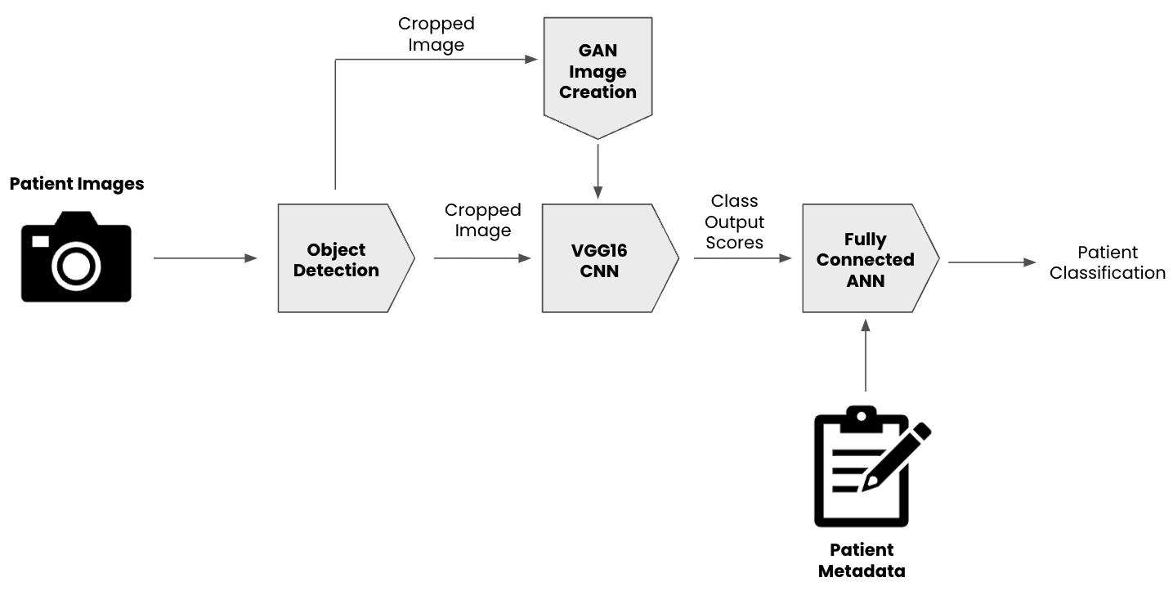
Training Process Flow
Machine Learning
Train/ Val / Test Split
by Patient
Notes:
Joe: To try to make remote COVID diagnosis a reality, we started by collecting data from a network of collaborators in the medical field.
The data included:
Age, Sex, and Race of the patient
Symptoms: fever, pain while swallowing, difficulty swallowing, cough, etc.
Date of Contagion (Approx.)
Clinical questionnaire for each photo of a patient with COVID
Pictures of a patient with or without added pathology (bacterial pharyngitis, another viral pharyngitis, or a healthy patient).
Then we started developing the architecture for the project, which

Slide 22
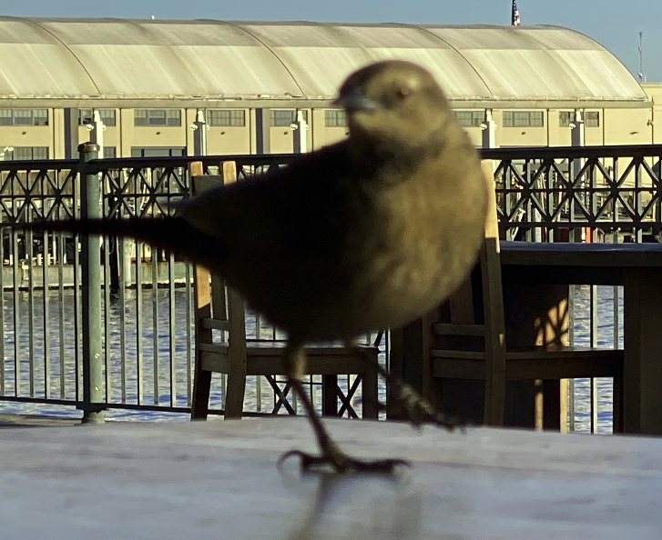
Data Preparation and Cleaning
The dataset also had to be cleaned.
Trimmed to include only the area of interest.
Removed images with very poor lighting or position.
Removed images that were not of the throat
Made additional adjustments based on EDA

